Slide 1
ATAI
Advanced Techniqueof Artificial Intelligence
ATAI
ChongqingUniversity _{AdvancedTechniqueof}
of Technology Artificial Intelligence
Chongqing University of
Technology
Chongqing University ^{ATAI}
_{of Technology} Advanced Techniqueof
Artificial Intelligence
Chongqing University of Technology
Chongqing University of Technology
Dense Audio-Visual Event Localization under Cross-Modal Consistency and Multi-Temporal Granular Collaboration
Code: https://github.com/zzhhfut/CCNet-AAAI2025.
—— AAAI 2025
Reported by Tingting Zhang
1

Slide 2
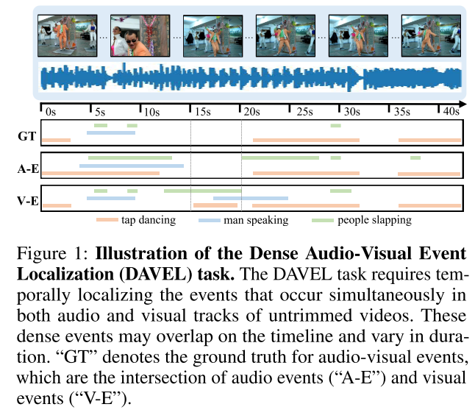
ATAI
AdvancedTechniqueof
Artificial Intelligence
ATAI
ChongqingUniversity _{AdvancedTechniqueof}
of Technology Artificial Intelligence
ChongqingUniversity of Technology
Motivation
Not all temporal segments contain audio or visual events, indicating that some segments may harbor background noise or other event-irrelevant information.
Each event may span various temporal windows. Considering interactions among audio and visual features at different temporal granularities would benefit the model.
Notes:
现有方法虽然取得了一定的性能，但仍存在以下几个缺陷：
1）跨模态特征融合不足。如图1（a）所示，现有方法通常采用拼接、相加、相似性重新加权和注意力来融合来自不同模态的特征。然而，诸如连接和添加的线性操作不考虑上下文语义信息。虽然相似性加权和注意力可以捕获跨模态特征的一致性，但它只代表了原始信息的一部分。
2)模糊特征分类现有的方法仅在新闻级别（图像-文本对）实现检测，并且不考虑特征级别（图像和文本之间）的差异。如图1（a）所示，由于来自不同新闻的跨模态特征的高度相似性，这可能导致图像-文本对的不正确配对。

Slide 3
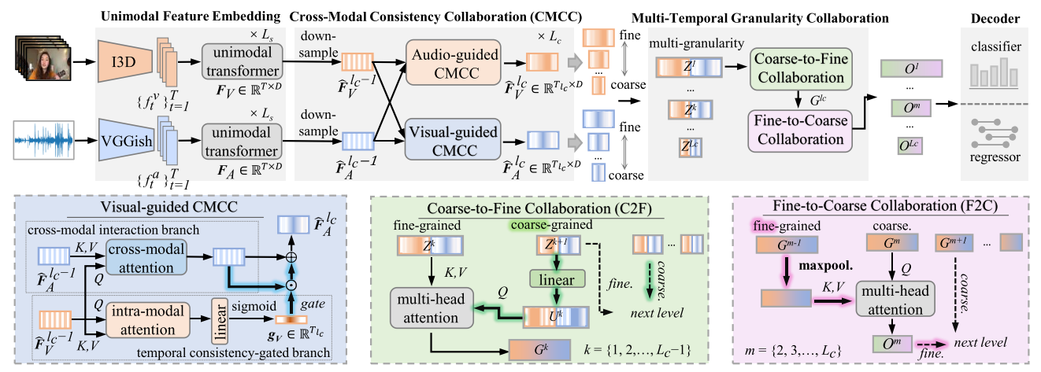
ChongqingUniversity of Technology
ATAI
AdvancedTechniqueof
Artificial Intelligence
ATAI
ChongqingUniversity _{AdvancedTechniqueof}
of Technology Artificial Intelligence
Overview

Slide 4
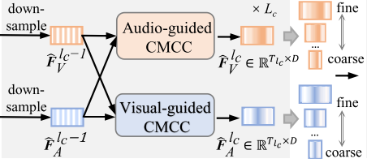
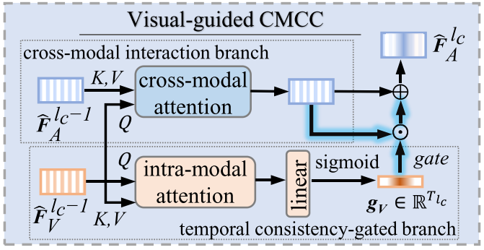
ChongqingUniversity of Technology
ATAI
AdvancedTechniqueof
Artificial Intelligence
ATAI
ChongqingUniversity _{AdvancedTechniqueof}
of Technology Artificial Intelligence
Method
Cross-Modal Interaction branch (CMI)
Cross-modal Consistency Collaboration
Temporal Consistency-Gated branch (TCG)
stride
Notes:
一个可变掩码阈值矩阵Θ，通过将查询和键连接到一个全连接网络中来计算

Slide 5
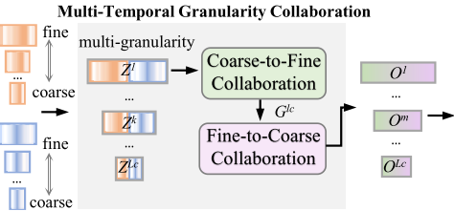
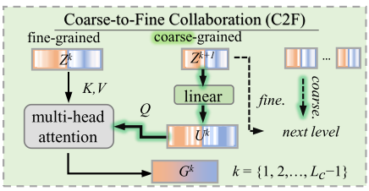
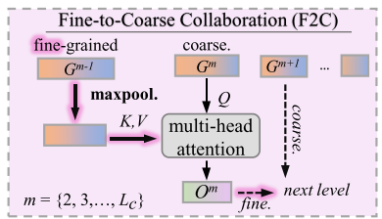
ChongqingUniversity of Technology
ATAI
AdvancedTechniqueof
Artificial Intelligence
ATAI
ChongqingUniversity _{AdvancedTechniqueof}
of Technology Artificial Intelligence
Method
C2F
F2C

Slide 6
ChongqingUniversity of Technology
ATAI
AdvancedTechniqueof
Artificial Intelligence
ATAI
ChongqingUniversity _{AdvancedTechniqueof}
of Technology Artificial Intelligence
Method

Slide 7
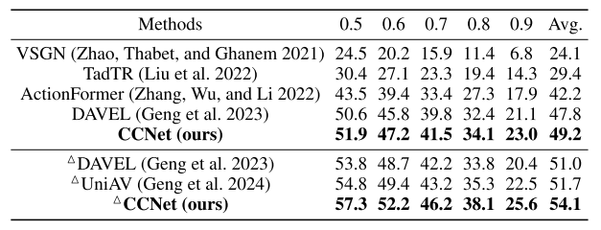
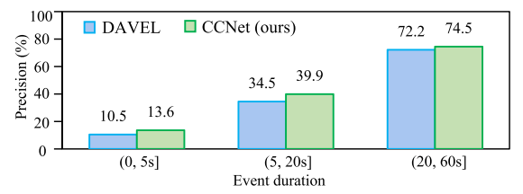
ATAI
AdvancedTechniqueof
Artificial Intelligence
ATAI
ChongqingUniversity _{AdvancedTechniqueof}
of Technology Artificial Intelligence
ChongqingUniversity of Technology
Experiments
We report mAPs at tIoU thresholds ranging from 0.5 to 0.9 in increments of 0.1.
Additionally, we report the average mAP (denoted as ‘Avg.’), calculated across an expanded range of thresholds [0.1:0.1:0.9],

Slide 8
ATAI
AdvancedTechniqueof
Artificial Intelligence
ATAI
ChongqingUniversity _{AdvancedTechniqueof}
of Technology Artificial Intelligence
ChongqingUniversity of Technology
Experiments

Slide 9
ATAI
AdvancedTechniqueof
Artificial Intelligence
ATAI
ChongqingUniversity _{AdvancedTechniqueof}
of Technology Artificial Intelligence
ChongqingUniversity of Technology
Experiments

Slide 10
ChongqingUniversity of Technology
ATAI
AdvancedTechniqueof
Artificial Intelligence
ATAI
ChongqingUniversity _{AdvancedTechniqueof}
of Technology Artificial Intelligence
Thanks!

